Slide 1
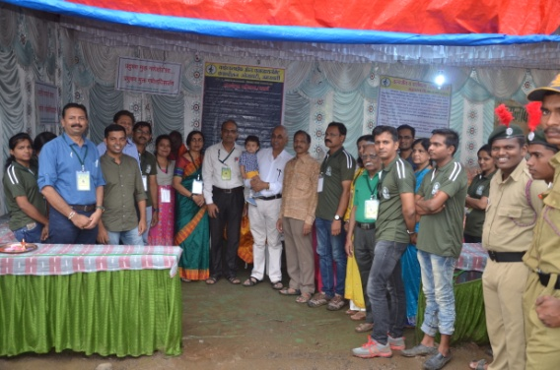
CLAY GANESH IDOL ACTIVITY

